Slide 1
Data Analytics Platform
ARCHITECTURE DESIGN DOCUMENT

Slide 2
Topics
Problem statement
ETL Architectures
Design considerations
Hadoop, Cloud, Kubernetes based Architecture
Architecture comparison
Ideal implementation for our ETL

Slide 3
Problem statement

Slide 4
Problem Statement
System Architecture
The source data is stored in on-premise RDBMS. The schema is like the transactional data in Part 1.
A daily ETL pipeline needs to ingest the data, do the same transformations as in Part 1 and store the output in the cloud where it can be queried.
The solution needs to be scalable in terms of data amount.
Optional: propose solutions for monitoring, logging and automated notifications.

Slide 5
ETL Architectures
Design considerations

Slide 6
Design Considerations
The system should scalable (add/remove compute power with no downtime)
Distributed, fault tolerant, highly available architecture
Easy integration with ecosystem components
Easy Observability and Monitoring
Easy Cost Management
Ease of Access Control, Policy Enforcement and Governance
Open source libraries backed by strong community support

Slide 7
Common ETL Architectures
Hadoop, Cloud, Kubernetes based Architecture

Slide 8

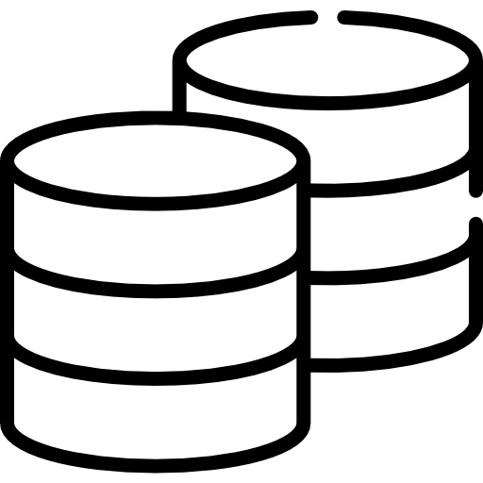












Traditional Architecture - Hadoop Based
Warehouse
Source of
Origin
External Data Sources
Landing Area
Staging Area
Consumption Area
Consumption/Visualization Layer
Hadoop Datalake

Slide 9











Modern Architecture - Azure Based (Generic/Simplified)
Data Source
Preparation and Storage
Analysis and Reporting
Microsoft Azure
Files
.
.
.
Ingestion
Processed Data
Process
Azure Key Vault
Azure Active Directory
Azure Monitor Service
Azure Billing Service
Governance and Monitoring

Slide 10




Modern Architecture - Azure (Deltalake)
Process (Build + Deploy + Orchestrate + Schedule)
Azure Data Factory
Azure Databricks
Azure ML
Serve
Store
Bronze Layer
Silver Layer
Gold Layer
Source
Files
Serverless Views
Ingestion
Pipelines
Bronze Layer
Silver Layer
Gold Layer
Azure Key Vault
Azure Active Directory
Azure Monitor Service
Azure Billing Service
Governance and Monitoring

Slide 11



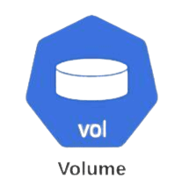




Modern Architecture - Kubernetes Based
Pipelining/Orchestration
Storage, Logging and Monitoring
Airflow
Storage
Postgres DB
Logging
Build (CI/CD)
DAGs
Images
Data Read/Writes
ETL Job
ETL Job
ETL Job
ETL Job
Containers
Org’s Image Repo
Computes
Kubernetes Pod

Slide 12
ETL Architectures
Architecture comparison

Slide 13
On-premise vs Cloud Based Setup
Factor | Hadoop Based (On-premise) | Cloud Based
Architecture | No isolation between Storage & Compute Storage and compute are tightly coupled | Complete isolation for Storage & Compute Better control over managing costs
Infrastructure Ownership & Maintenance | Self managed, often manual Complex | Cloud provider manages, no manual effort Easy
Scalability | Complex May require hardware procurement | Easy Auto resource allocation for scaling requirements
Cost Model | Requires upfront capital investment Recurring maintenance cost | Pay as you go No maintenance cost
Data Location | Geo replication is hard and self managed Disasters might impact availability | Geo replication is easy and automatic Less impact on availability during disaster
Resource Utilization | Inefficient due to fixed capacity High during peak time, otherwise underutilized | Very efficient due to autoscaling No resource crunch, system scales as it requires
Kubernetes based infrastructure could be setup by either:
Subscribing to fully managed services from public cloud providers (Pay as you go)
Migrating capacity from existing on-premise clusters to implement Kubernetes based clusters (fixed cost)
Wide variety of open source tools for Processing, Storage, Scheduling & Orchestration and Observability

Slide 14
Ideal implementation for our ETL

Slide 15
Task 2: Architecture - Azure Cloud
Azure
Synapse
Azure Key Vault
External Dashboards
Files
Source
Landing Zone
Staging/Serving Area
Microsoft Azure
PostgreSQL
External Dashboards

Slide 16
Task 2: Architecture - Containerized Microservices
Airflow
Postgres DB
Build (CI/CD)
DAGs
Images
ETL Job
ETL Job
ETL Job
ETL Job
Containers
Org’s Image Repo
Kubernetes Pod

Slide 17

End of presentation
Have a great day ahead

